Slide 1

HELIXON
The helmet that you need :)

Slide 2
TEAM MEMBERS
TEAM MEMBERS
ABDUL KAREEM FARIDH V T
KIRANRAJ R
GANESH KARTIK R
MENTOR
MENTOR
Dr SATHYA PRIYA J

Slide 3
COMPONENTS
Camera Module.
Wifi Module.
Storage(Cloud Storage).
Power On Ethernet(POI).
Application For Access.

Slide 4

HELIXON
Hello!
EVERYONE
ABSTRACT
Helixon , which is in fact a helmet activated with a safety camera . This store and back up your daily trips that can prevent bicycle drivers from insurance scam.

Slide 5
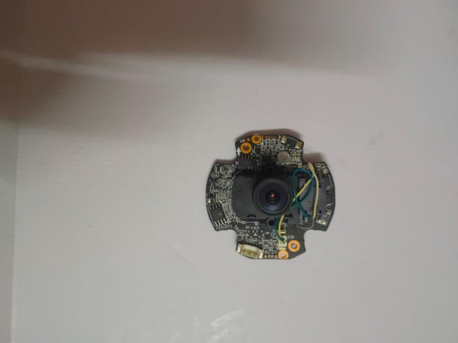
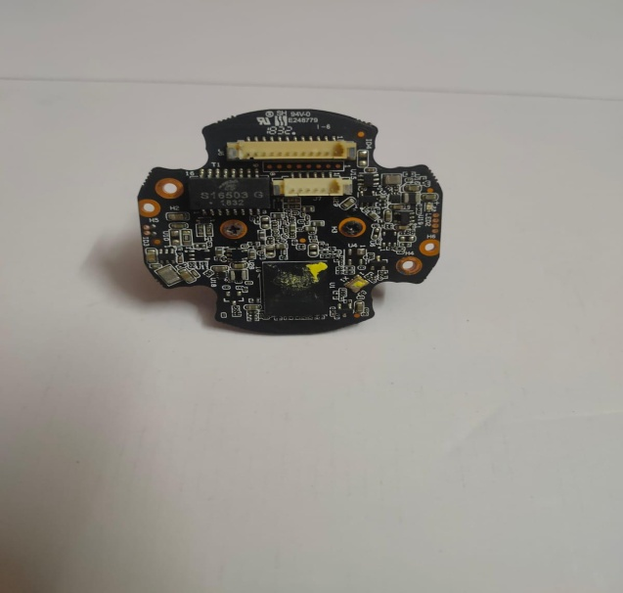
HELIXON
CAMERA MODULE
This is essentially a CCTV camera composed of 4mp MegaPixel, activated with night vision and also have a mic.
This Camers is used to record the real-time-footage of your daily ride.
This footage will be autmatically stored in the cloud.
This camera need 6 power backups , Which can hold charge upto 4-5 hours.

Slide 6
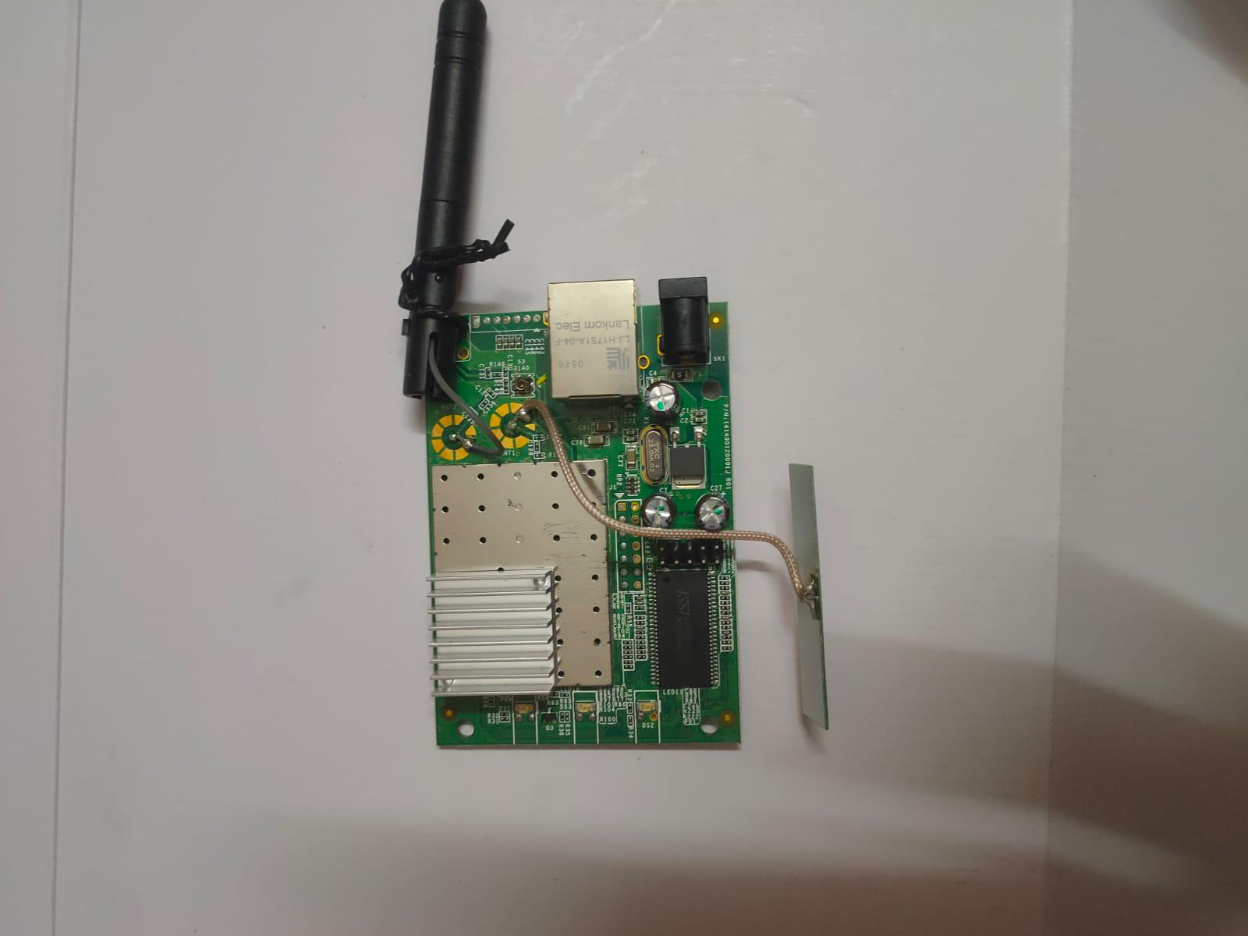
HELIXON
WIFI MODULE
The Wi-Fi module generally contains two main parts: a Wi-Fi chip and an application host processor. The Wi-Fi subsystem includes an 802.11 radio physical layer (PHY), baseband, media access control (MAC), and perhaps a crypto engine for fast, secure Internet connection. The application host processor has internal or external flash, ROM, and RAM.
This Module is used to tansfer your real time video directly into the cloud.

Slide 7
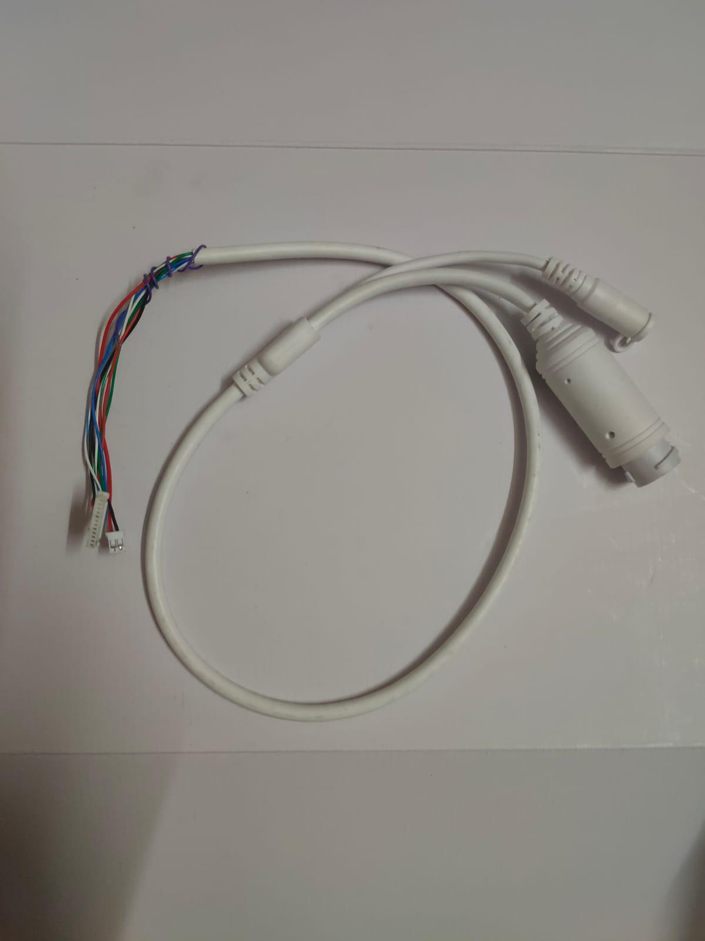
HELIXON
Power On Ethernet (POE)
POE cable which is used as both video & power supply in single port.
And at other end a 12V connecting wires can be used in case if we dont have POE switchbox as a secondary power supply
If we dont have a POE switch,we can use direct USB cable d=for data tansfer.

Slide 8
HELIXON
CLOUD STORAGE
We are Using an Application which will always be connected with the google drive.
since its being connected you can always review your real time data for security needs.
This will have the site that says, Where this specific video was taken.

Slide 9
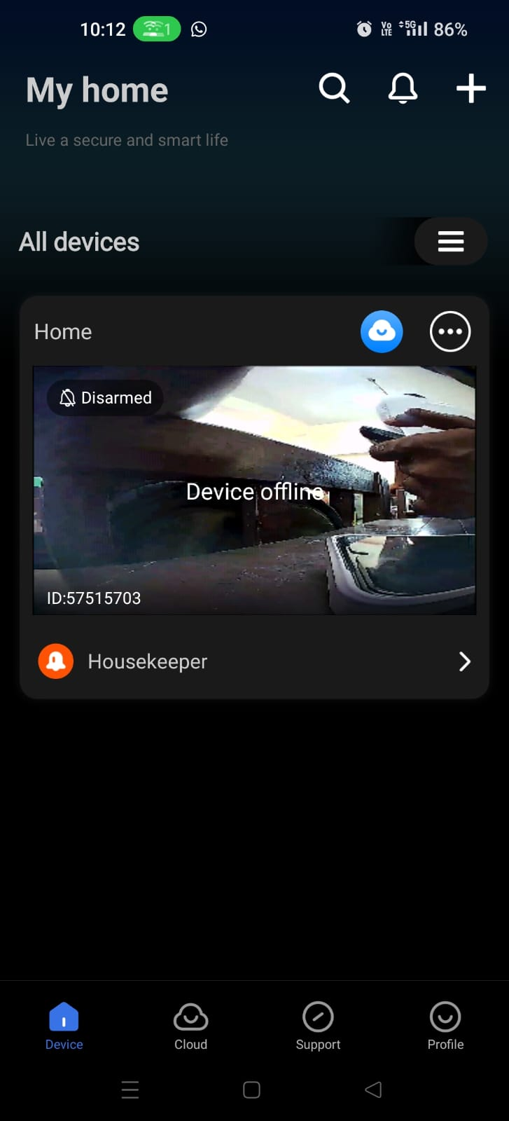
HELIXON
APPLICATION
We are creating an app that will connect to your google drive.
This app alows real time tracking of your Helmet.
By using this app we can contol the camera.

Slide 10
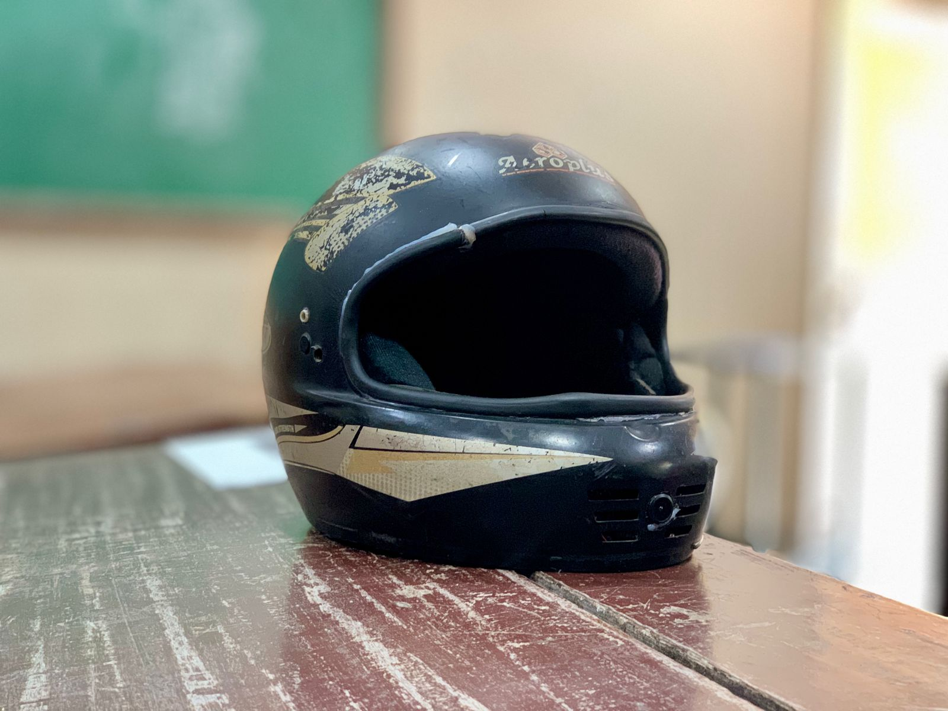
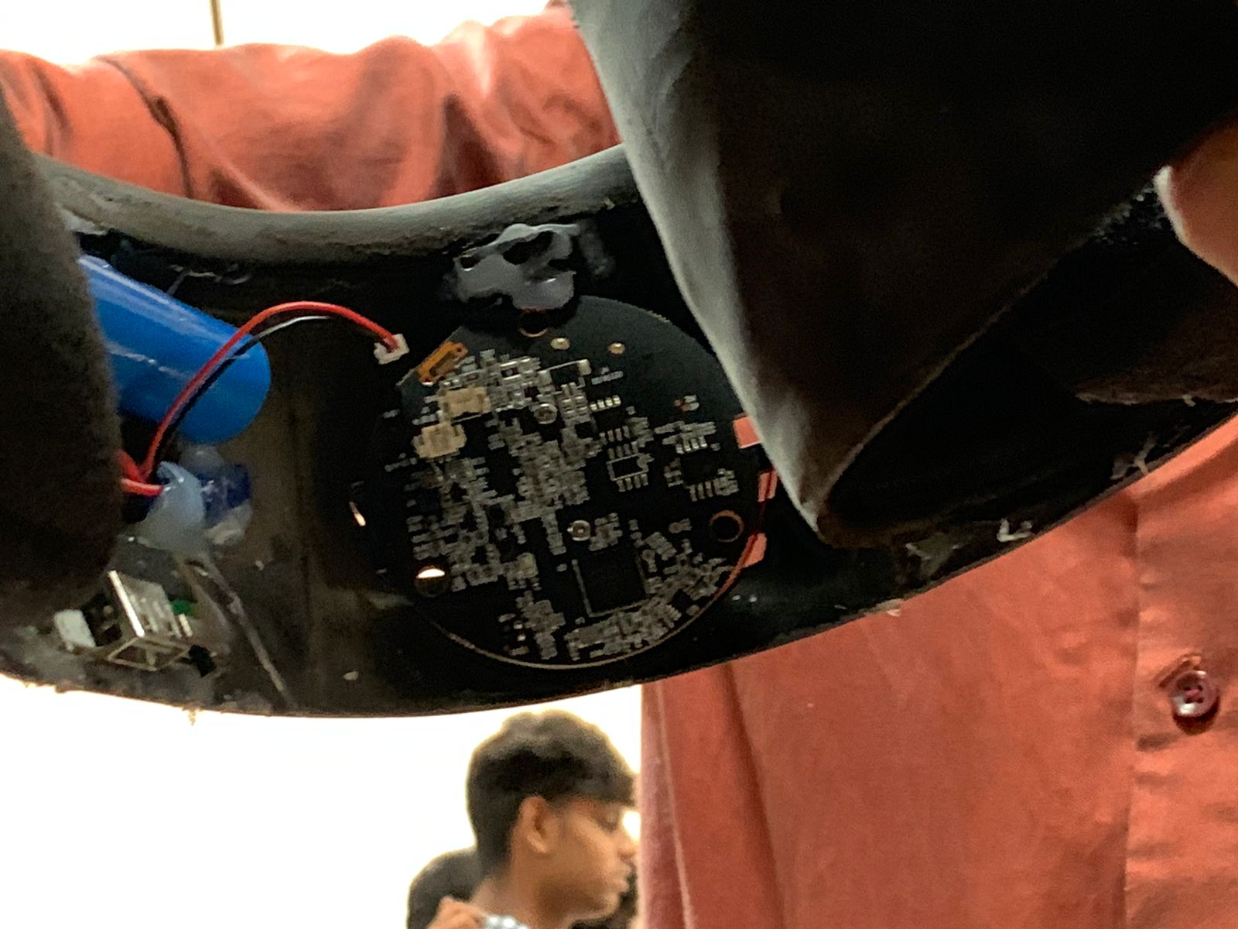
HELIXON
COMPLETED OUTPUT:

Slide 11
HELIXON
DIFFERENCE
HELIXON
Normal Helmet With GoPro
This contains camera that can record in realtime footage.
This will store your data in cloud.
Alerts near by police station, if and when the helmet undergo any accident or anykind of unwanted actions.
Makes it easy for police investigation, during the above said actions as the data is stored in the cloud.
Cost effective.
It does not provide you the features of Helxion without GoPro.
No alerting system.
No cloud storage, need SD card for storing the data.
AVG cost of GoPro is Rs.29,000.

Slide 12
Thank You

